Slide 1

Notes:
-We are an app, but we are also a business

Slide 2



Current Problem
Volunteers
Organizations
Notes:
Lack of ability to find places to volunteer
Lack of ability to find dedicated, high quality volunteers
Ambiguity about certain volunteer opportunities
divide

Slide 3

Volunteers
Organizations
“Volunteer Buddy, the heart of volunteering”

Slide 4

Our Mission
To not only increase community involvement by helping volunteers find opportunities to give back, but provide the go-to for volunteers and all types of organizations to have an even higher impact on the community by matching the perfect volunteers to the perfect opportunities.
Notes:
Our mission is to encompass the entire volunteer experience, in a mobile app, making it an easy, rewarding, and social experience.
-We are an app, but we are also a business
We will revolutionize the volunteering experience, helping organizations find the best possible volunteers that they need, and helping volunteers find the opportunities that they want to pursue.

Slide 5
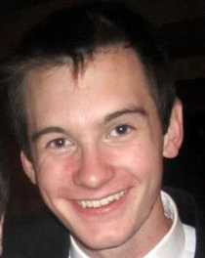
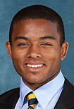
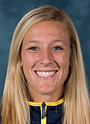
The Team
Notes:
We all love volunteering, and community service. As a college student I often found it hard to find volunteer opportunities. As I sat there, thinking of places to volunteer, it hit me. Why not create a mobile app to simplify the volunteer experience. Here we are 3 months later with a hardworking, passionate team. We all bring a different piece to the puzzle, just like volunteers at non-profit organizations and events.
We are all social entrepreneurs who want to change the world. We believe that Volunteer Buddy is the key to endless doors of volunteer opportunities. It will increase volunteering across the board, thus increasing the help provided for many people.
Joshua Upfal
Communication Studies, Entrepreneurship, & Performing Arts Management/Pre-Law
Chloe Prince
Informatics & Computing Services, Entrepreneurship
Robby Greenfield
Computer Science & IOE
Jake Hash
Computer Science & Entrepreneurship

Slide 6
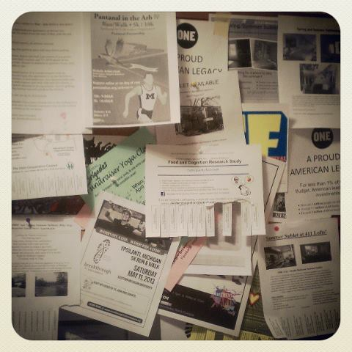
1
2
3
4
Find
Match
Share
Information

Slide 7
1
Find
Volunteers
Organizations

Slide 8
2
Match

Slide 9
3
Share

Slide 10
4
Information

Slide 11
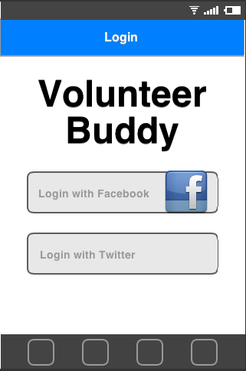
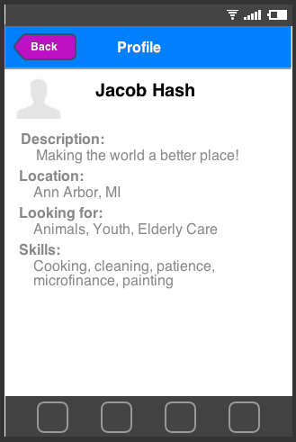
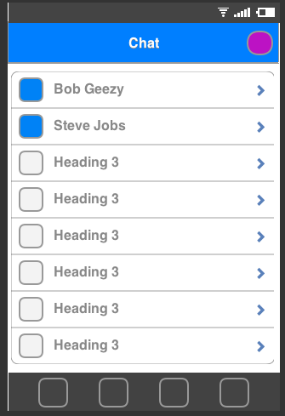
Mobile App Demonstration
Notes:
https://www.fluidui.com/editor/live/preview/p_BSbtvmQbRV7EiEQu6rdpDlKDvAQieIWw.1363984877598
User Features
-Locate organizations
-Find events and opportunities
-Easy access to information on organizations and events (necessary skills, location, time and date, contact information, reviews)
-Sign up for events and opportunities through the click of a button, ability to cancel through the click of a button (notifies the organization)
-Subscribe to organizations for updates
- check in at events
-Profile page with hours gained, skills and interests, volunteer history, and favorite places to volunteer
-Chat system to connect with organizations and friends
-Ability to create events and invite friends
-Share experience through social media
-Calendar to keep track of events and opportunities
-Leader boards
-Google Maps, Facebook, Twitter, Foursquare, Calendar (Iphone/Gmail)

Slide 12
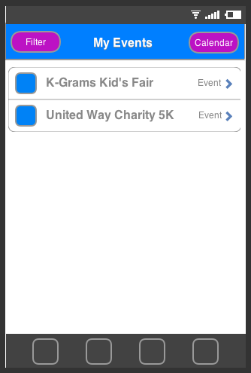
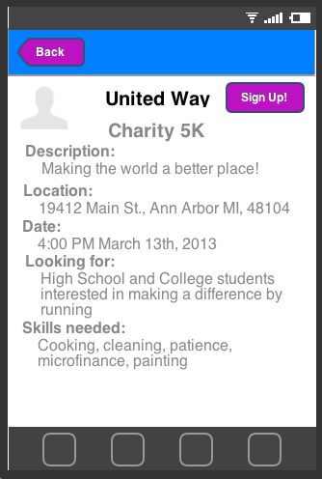
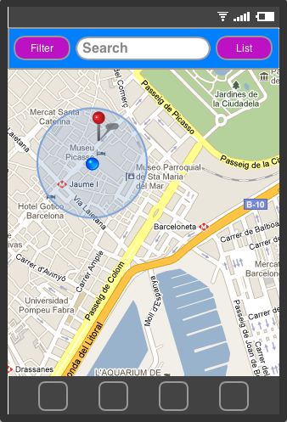
Notes:
Organization Features
-Separate Log-in portal
-Create events and invite volunteers
-Create events and invite volunteers
-Invite volunteers based on skills, age, interests, hours, and past experiences
-Ability to see who is coming to the event and how many people
-Ability to connect with volunteers prior to events/volunteer opportunities
-Ability to see who has checked in at the event, and who has not
-Ability to give hours to volunteers who have checked in

Slide 13










Customer Discovery
Non-Profits
PO Offices
Festivals & Fairs
High schools
Notes:
-We are still still working on customer discovery. It is a continuous process
United Way, The Friendship Circle,, The Ann Arbor Arts Center, The Food Gatherers
Dexter High School, Pioneer High School, Skyline High School
PO Officer
The St. Mary’s Fair
-Mention how we started as an app for gamifying volunteering and rewards,
But through customer discovery we recognized that people do not volunteer for rewards,
But more so for the social benefit of volunteering, and helping others, and also for school requirements
-Also organizations are not thrilled about volunteers coming just to get coupons, they would
Rather volunteers be sincere, high quality and authentic, which is something that Volunteer Buddy can provide,
As well as large amounts of valuable information
High School Students, initially students in National Honors Society
Students and people involved in community service based organizations
Anyone who wants/needs community service hours
Non-profit organizations
Festivals and events

Slide 14
What We Know
High School Students would use our app because…
College applications, build friendships, giving back, High School requirement
More volunteers, trouble with accessibility, narrow opportunities down, make friends, easier access, easier to keep track of hours, group experiences
Notes:
-Within High Schools NHS Organizations would use our app,
Because…..

Slide 15
Our Revenue Stream
Subscription Model Vs. Pay-Per-Volunteer Model
One Time Use Vs. Long Term Fee
Information is the value
Notes:
Our primary focus is to create the app, then we will test it with certain organizations, to validate that we can bring more volunteers to organizations through the app

Slide 16
Features |  | Volunteer Match | Reward Volunteers | Cause.it | VolunTeens
Mobile App | ✓ | ✓ | ✓ ios only | ✓
Calendar | ✓ |  |  | ✓ | ✓
Geo Location | ✓ |  |  | ✓
Public | ✓ | ✓ | ✓ | Students | Palm Beach & Broward Counties (FL)
Profiling | ✓
Map View | ✓ | ✓
Social Aspect | ✓
Gamification | ✓ |  | ✓
Reviews
Notes:
Rewards

Slide 17





Volunteers
Organizations
Notes:
Lack of ability to find places to volunteer
Lack of ability to find dedicated, high quality volunteers
Ambiguity about certain volunteer opportunities
divide

Slide 18


Slide 19
Projected Five-year Timeline
2013
Launch Volunteer Buddy in Ann Arbor
2014
Expand to rest of Michigan and various festivals across the nation, SXSW
2015
Expand across nation, making VB the standard in high schools and non-profit organizations
2016
Expand to more festivals
2017
Cash-flow Positive

Slide 20






